Slide 1
Customer Attrition Prediction
on credit card data
Capstone Project
Data Science Career Track, Springboard
Thanks to mentor Julian Jenkins III

Slide 2
Objectives:
Explore the dataset and visualize the same
Build a model to predict the customer is going to churn or not
Optimize the 4 models with appropriate techniques
Generate a set of insights and recommendations that may help the bank

Slide 3
Introduction
Problem Statement
The customer churn, also known as customer attrition, refers to a customer ending relationship with a company for some reasons.Identify and visualize which factors contribute to customer churn.
Credit card dataset is used.
Source :
From google data search
https://www.kaggle.com/sakshigoyal7/credit-card-customers
OR
https://www.kaggle.com/c/1056lab-credit-card-customer-churn-prediction/data

Slide 4
From the Initial Analysis
Average customer age is ~46 and min and max customer age is 70 to 82.
Average period of relationship with the bank is ~36 months with a minimum of 13 and max as 56.
Average Total number of products with the customer ~4 and maximum is 6.
Mean of Credit_limit 8631 while median is 4549 ,data may have outliers.
Total_Revolving_Bal(unpaid portion) has mean as 1162 while median is 1276, No outliers.
Avg_Open_To_Buy(amount left on the credit card) has mean 7469 and max as 34516.Appears some outliers.
Total_Trans_Amt has an average of 4404 and median of 3899. This indicates outliers.
My target variable is :Attrition_Flag: if the account is closed then "Attrited Customer" else "Existing Customer"

Slide 5
Data Exploration
There are 10127 rows and 23 columns.
Checked for missing values
Checked for Null
Checked for missing values
Checked for unique values
Weird values or filled, for example “unknown”
Corrected weirdly formatted values(income category)

Slide 6
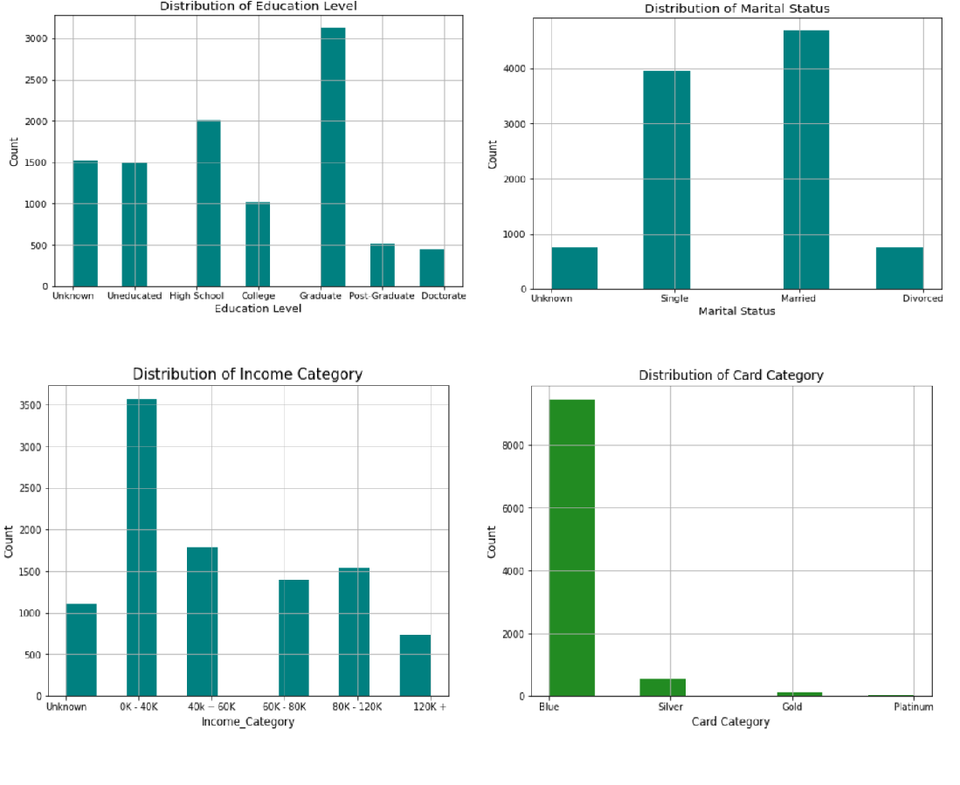
Data Exploration
"Unknown" for fixed with respective mode for these -
Education_Level
Marital_Status
Income_Category
Arranged in order -
Education_Level
Marital_Status
Income_Category
Card_category
Plots for categorical features arranged on order

Slide 7
Feature Scaling:
4 different types scaling is applied -
z-score scaling : Approximately normally distributed
Divided by Median: related by magnitude or right skewed
Log scaling:related by magnitude
Square root : for counts

Slide 8
Z Scoring
Z-Score Scaling - number of standard deviations away from the mean
Formula for Z-score = (Observations - Mean)/Standard Deviation
Applied zscore scaling on to 4 features and created all 4 new columns with "_zscore" suffixes,created all 4 new columns with "_zscore" suffix
Customer_Age
Months_on_book
Total_Trans_Amt
Total_Trans_Ct" and

Slide 9
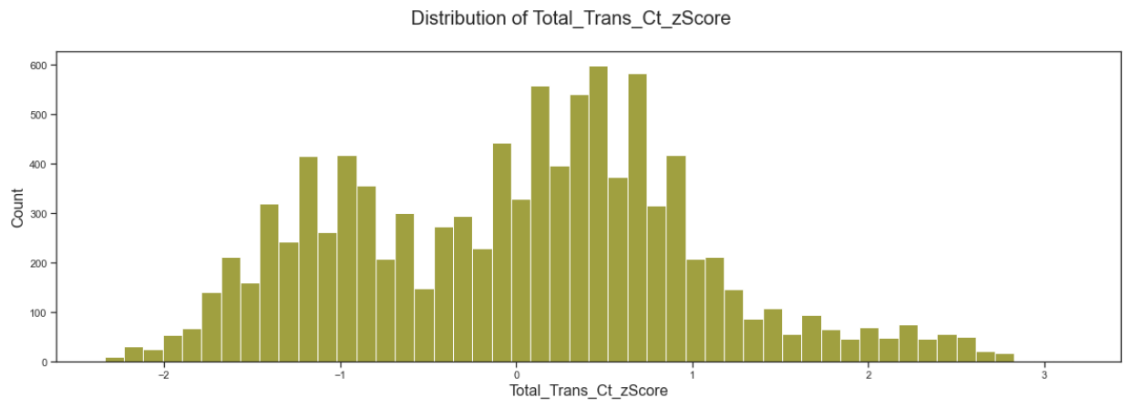
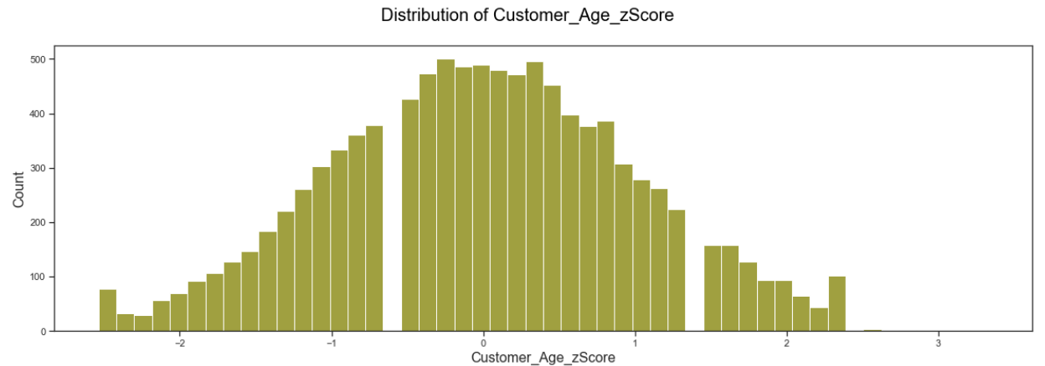
Z Scoring
z-scoring on total_trans_ct and Customer_age

Slide 10
Z Scoring
Outliers were checked with threshold value 3 for these features and found -
391 outliers for Total_Trans_Amt (Total Transaction Amount in Last 12 months)
124 outliers for Months_Inactive ( No. of months inactive in the last 12 months)
54 outliersfor Contacts_Count (No. of Contacts between the customer and bank in the last 12 months)
2 outliers for Total_Trans_Ct (Total Transaction Count in Last 12 months)
1 outliers for Customer_Age
and none for Months_on_book (Time frame with the Bank)

Slide 11
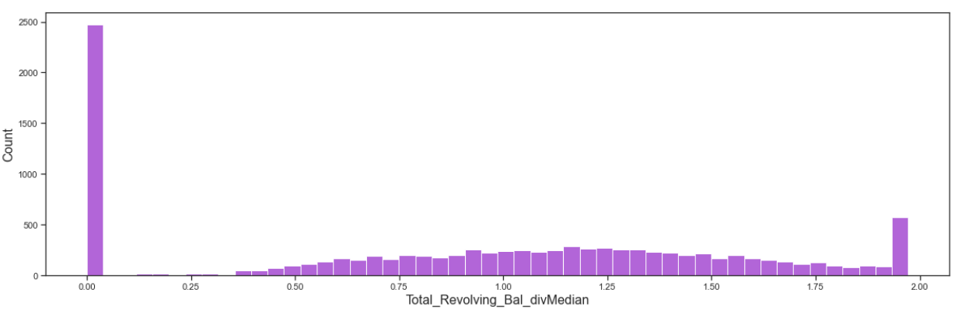
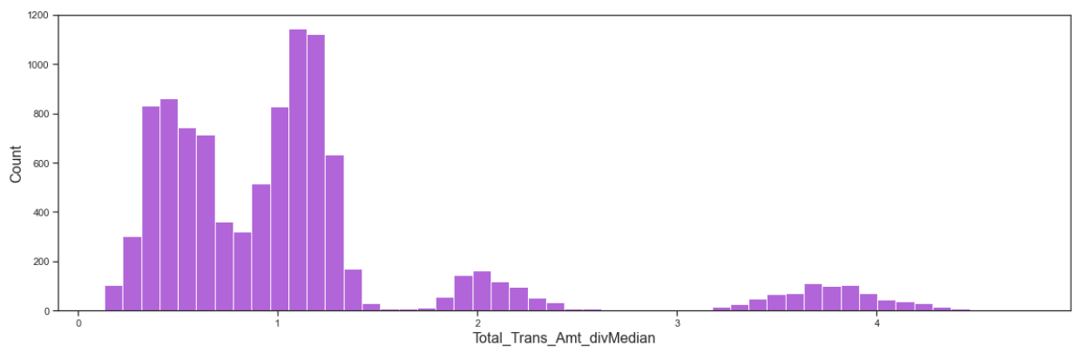
Divided Median
Applied dividing median scaling on 6 features, and those are "Credit_Limit" and new columns created with"_divMedian" suffix.
Total_Revolving_Bal
Avg_Open_To_Buy
Total_Trans_Amt
Total_Amt_Chng_Q4_Q1
Total_Ct_Chng_Q4_Q1
div median on total_revolving_bal and total_amt

Slide 12
Divided Median
Found these features Skewed to the left.
Credit Limit -Credit Limit on the Credit Card
Total_Trans_Amt -Total Transaction Amount in Last 12 months
Total_Amt_Chng_Q4_Q1 - Ratio of the total transaction count in 4th quarter and the total transaction count in 1st quarter
Total_Trans_Amt - Very interesting, right skewed, bimodal with outliers
Avg_Open_To_Buy - The amount left on the credit card to use

Slide 13
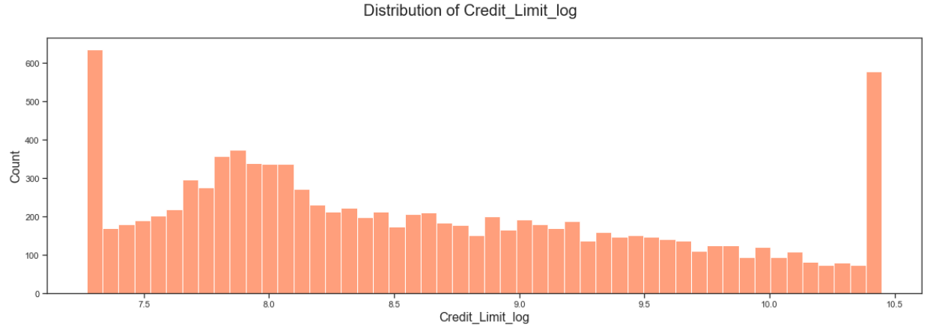
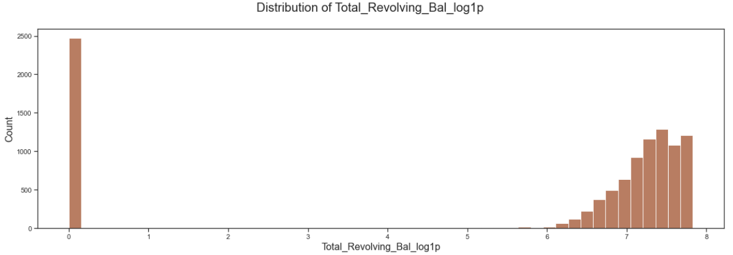
log transformation
Log transformation is applied for these 3 column and new columns are created with suffix "_log"
Credit_Limit
Avg_Open_To_Buy
Total_Trans_Amt
for Total_Revolving_Bal as this has the "0" values, log1p scaling is applied.
log transformation on total_revolving_bal and total_amt

Slide 14
Log transformation
Credit_Limit: Credit Limit on the Credit Card - slightly left skewed, with spike on extremes.
Avg_Open_To_Buy: The amount left on the credit card to use - right skewed with outliers

Slide 15
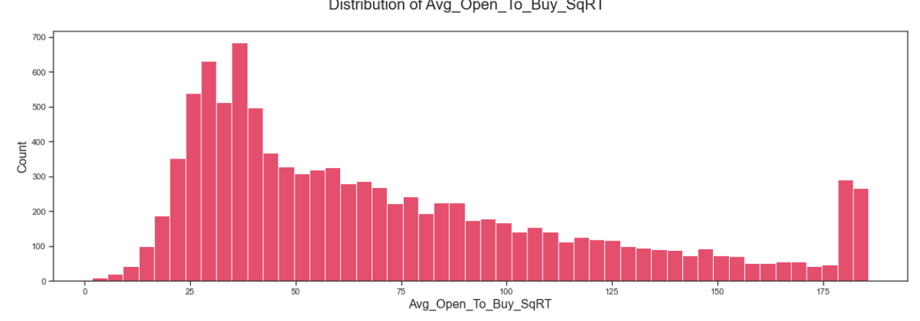
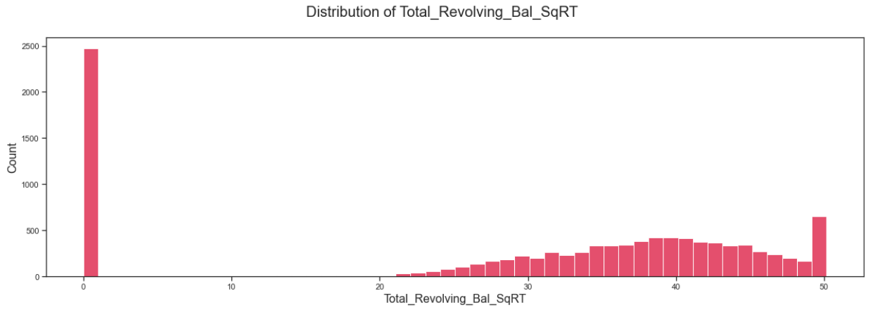
sq root scaling
This is applied to "Total_Trans_Amt and new columns are created with suffix "_SqR"
Credit_Limit"
Total_Revolving_Bal
Avg_Open_To_Buy
otal_Trans_Ct
Sq root applied on avg_open_to_but and total_rovolving_bal

Slide 16
Data Wrangling : Conclusion
All together 25 new columns are added, making 48 columns in total.
No columns are dropped
Sq root applied on avg_open_to_but and total_rovolving_bal

Slide 17
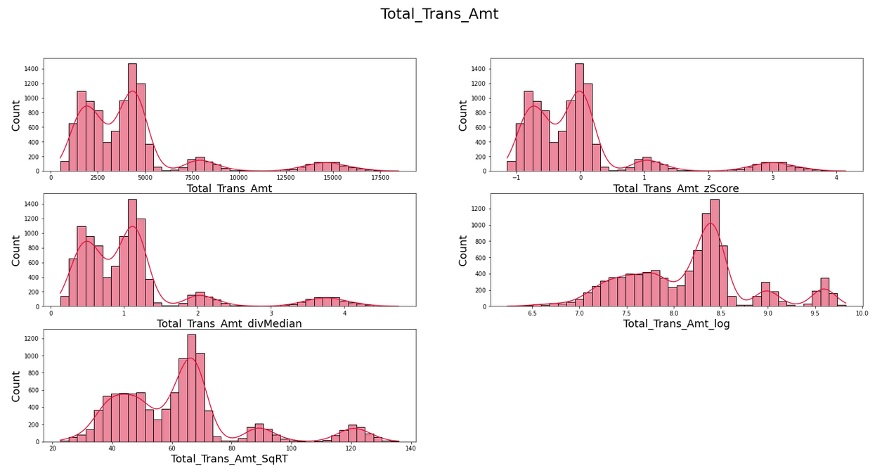
Exploratory Data Analysis
feature relationship is evaluated.
Scaled features are compared with original features with help of hist plots.

Slide 18
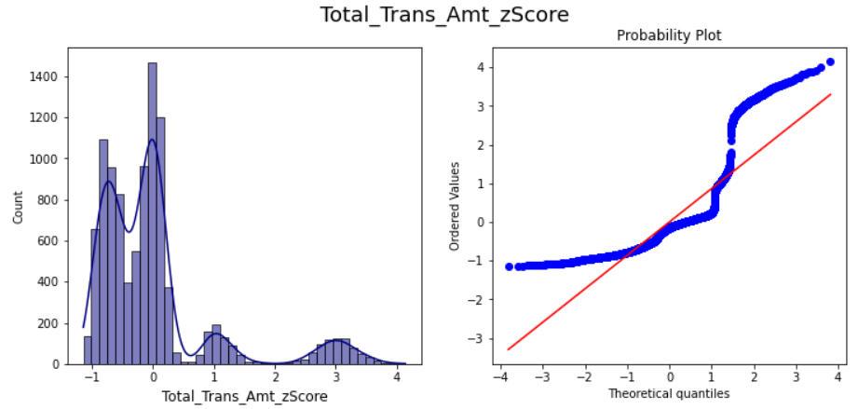
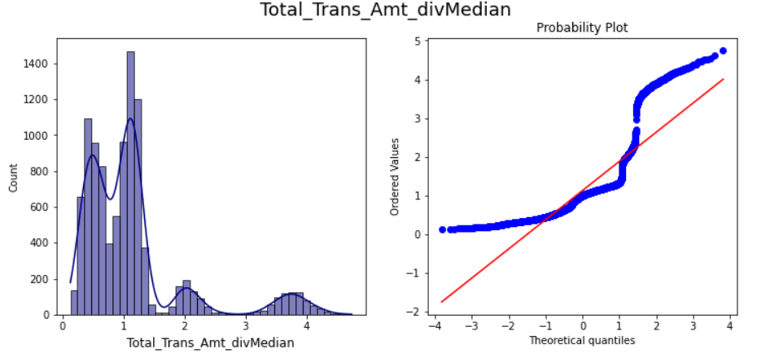
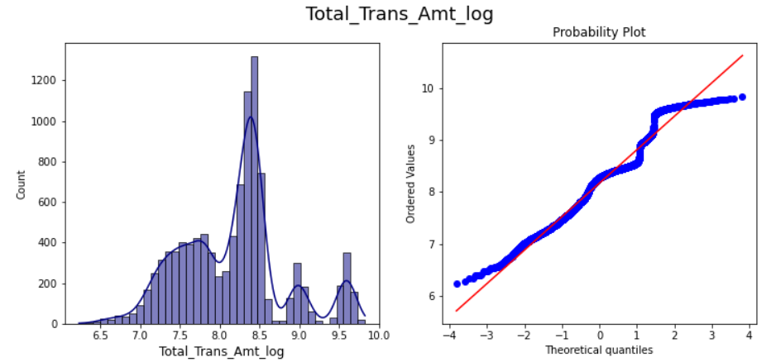
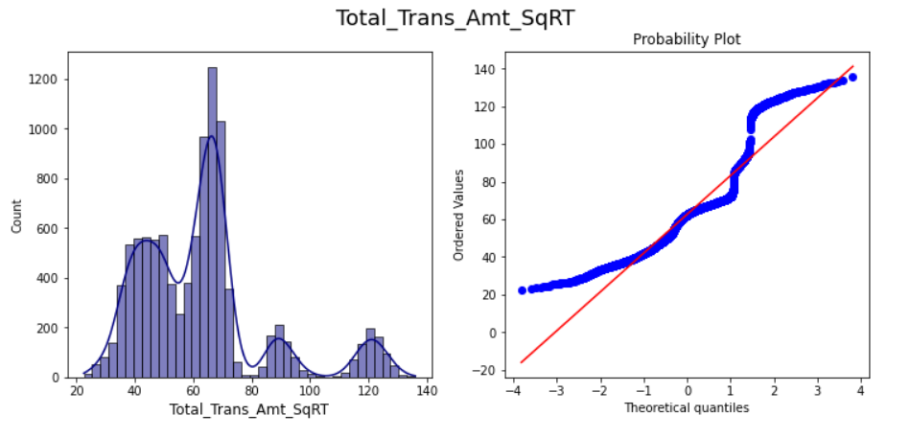
Exploratory Data Analysis
Features are verified for Gaussian or Normally Distributed using Q-Q plot.
Sample q-q plots for Total reans amt for all scaling

Slide 19
Exploratory Data Analysis
After Comparing each scaled feature with the original and with the help of Q-Q plot, below scaled features are selected for further exploration.
Customer_Age_zScore
Credit_Limit_log or div Median
Total_Revolving_Bal_divMedian
Avg_Open_To_Buy_log or div Median
Total_Amt_Chng_Q4_Q1_divMedian
Total_Trans_Amt_log or zScore
Total_Trans_Ct_zScore
Total_Ct_Chng_Q4_Q1_divMedian
Months_on_book_zScore
Total_Amt_Chng_Q4_Q1_divMedian

Slide 20
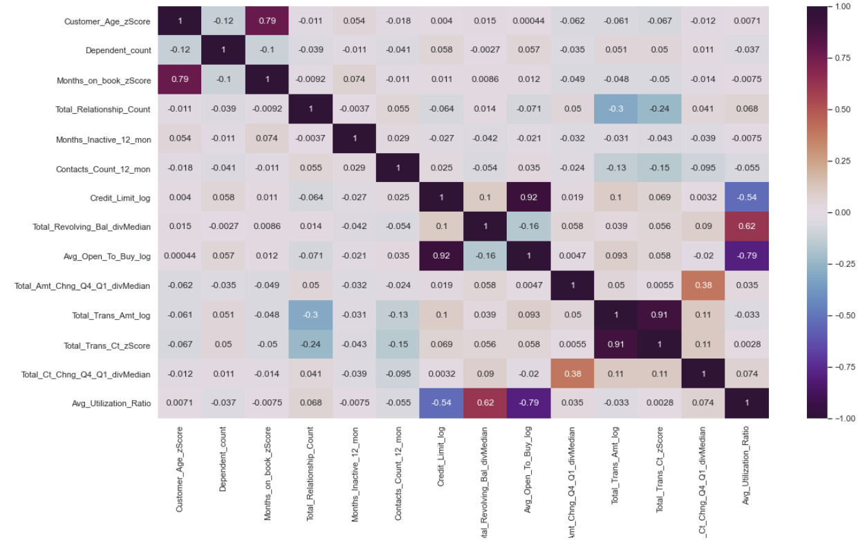
Exploratory Data Analysis
Feature Correlation heat map

Slide 21
Exploratory Data Analysis
How correlations across the features are Analysed -
As expected there is very high correlation between total transfer amount and total transfer count. Total transfer count is dropped.
Credit limit and Average open to buy is fully correlated, Average open to buy is dropped..
Total_Trans_Ct and Total_Trans_Amt are close for fully correlation,.91, Total trans count is dropped.
It is also logical that Total_Trans_Amt is correlated to Total_Amt_Chng_Q4_Q1,total ct_change_Q4_Q1. Total_Amt_Chng_Q4_Q1,total ct_change_Q4_Q1 are dropped.

Slide 22
Exploratory Data Analysis
How correlations across the features are Analysed -
Customer age and Time frame with banks are highly correlated.
Credit limit and Avg utilization ratio(how much of the available credit the customer spent) has some negative correlation.
Total revolving balance (balance that carries over from one month to the next and average utilization (how much of the available credit the customer spent) are positively correlated.As expected.
Average opening balance is negatively correlated to avg utilization ratio.
There is very little correlation between total transfer amount and credit limit

Slide 23
Exploratory Data Analysis
After feature scaling the final list of features for the pre-processing looked follows and Target is 'Attrition_Numeric'
Customer_Age
Credit_Limit
Total_Revolving
Total_Trans_Amt
Avg_Utilization
Gender_Encoded
Dependent_count
Education_Level_sorted
Marital_Status_sorted
Income_Category_sorted
Card_Category_sorted
Months_on_book_zScore
Total_Relationship_Count
Months_Inactive_12_mon
Contacts_Count_12_mon

Slide 24
Pre-Processing
Applied the scaling best found from the EDA as follows
Z scoring for "Customer_Age","Months_on_book"
Div median for 'Total_Revolving_Bal'
Log scaling for "Credit_Limit","Total_Trans_Amt"
Test and Train sets are created with 80:20 ratio.

Slide 25
Modeling
Model used are
Logistic Regression
Random Forest Classification
KNeighbours Classification
XGBoost Classification
Steps followed to build model are
Set the model object, Pipeline, cross-validator, etc.
Evaluate the fit on the training data (make sure everything is working,
is the metric acceptable?)
Pick the threshold (using the training data)
Evaluate on the test data
Compare train and test results

Slide 26
Evaluation Metrics
Confusion Matrix:
Classification Report :
Precision:- What percent of predictions were correct?
Accuracy of positive predictions.
Precision = TP/(TP + FP)
Recall — What percent of the positive cases were correct?
Fraction of positives that were correctly identified.
Recall = TP/(TP+FN)
ROC_AUC : ROC is a plot of True Positive Rate (TPR) against False Positive Rate (FPR)
predict the actual class of the data point by predicting its probability of belonging to different classes.

Slide 27
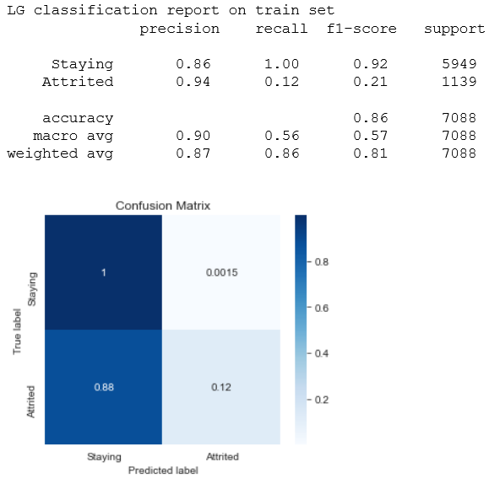

Logistic Regression: Metrics Evaluation
This model is generalized better on train set and test set.However roc_AUC score 0.75, means it can 75% chance of identifying default and non-default class.Recall perfect for defaults, precision is 0.85. only. Indicating this model can not predict the defaults correctly, but non-deaults are predicted as defaults. Meaning those who are actually attrited are predicted as existing. However it is better than naive model.Can identity majority class much better, but still not to the expectation.

Slide 28
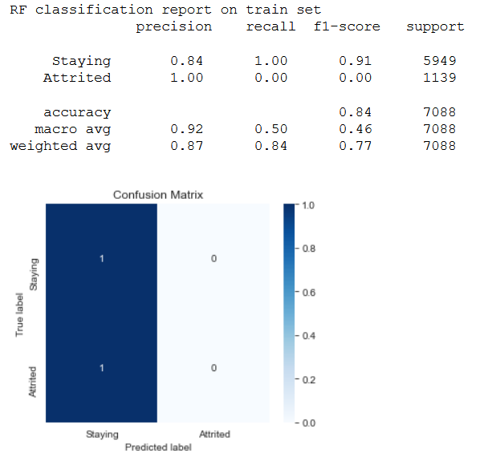
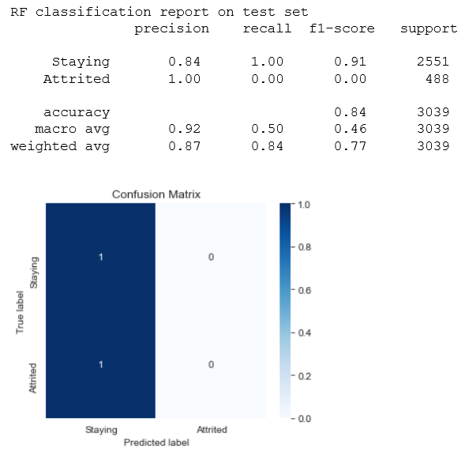
Random Forest Classification: Metric Evaluation
This model performed poorly in comparisonto logistic regression. Same as naive model. Grid search may yield better results with hypertuning params, can also try feature importance and apply top 3 or 5 features to get better results. Though recall is 1, +ve predictive rate precision is 0.84. Indicating 84% chance of correct prediction on defaults to non-defaults.
Hyper param tuning did not play the role, it is same as naive model.

Slide 29
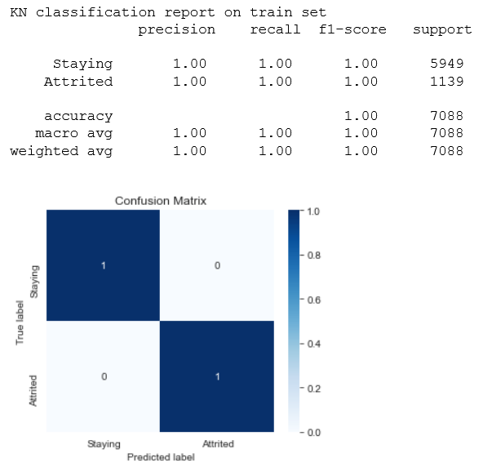

KNeighbours Classification: Metric Evaluation
KNeighbours is performing same as Random Forest on Test set. However Max roc_auc is perfect 1 on train set,meaning model can identify between all the defaults and the non-defaults points correctly. This is supported with confusion matrix of train set. However on applying to test set it is visible False -ve is 1, and true -ve is 0. can be seen with precision 0.84 Hyper param tuning did not play the role, it is same as naive model.
It is potential that all may be predicted as true +ves meaning, there is attrition, Actually customers are leaving.

Slide 30
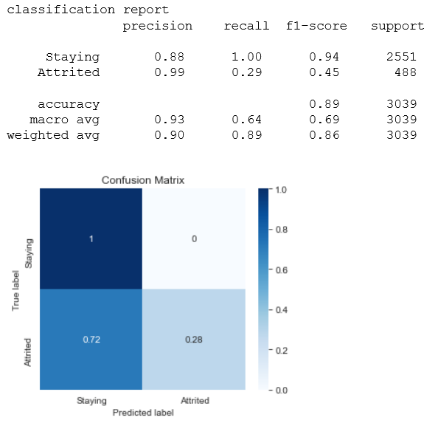
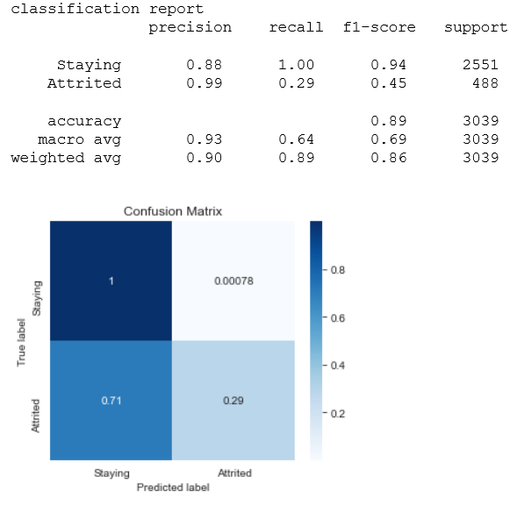
XGBoost Classification: Metric Evaluation
This is generalized better compared to all modeland performed fairly well, as false -ve rate is 0.7 compared with logistic and random forest on both on train and test set. And I can see true +ve rate stayed 1, with recall 1 and improved precision 88%.generalized. This brings a model that can fairly make mistakes in unseen data, in comparison to other models.

Slide 31
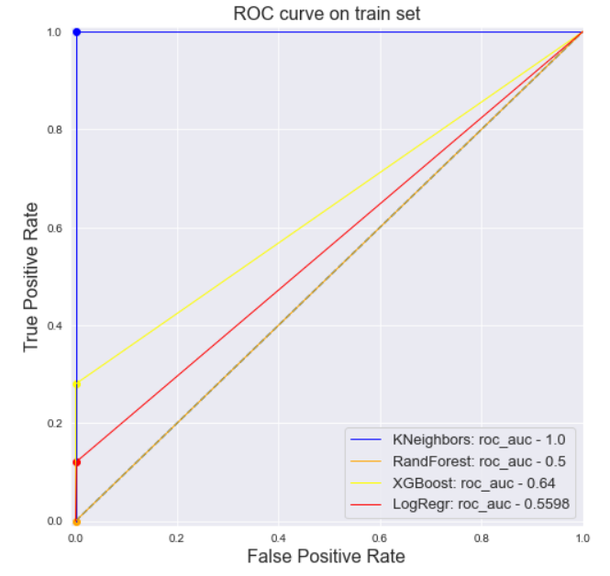
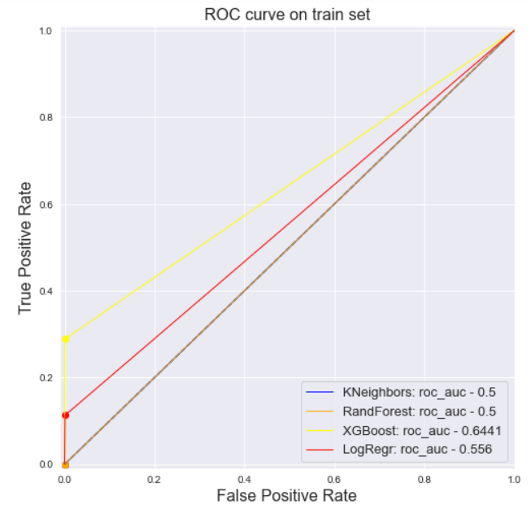
ROC_AUC Curve Comparison

Slide 32
ROC_AUC Curve Evaluation
Logistic regression is performing well on both training and test sets. With a score of 0.55 This is generalized better.
KNeighbors performed very badly on train is 1.0 and on test data with roc_auc 0.71. It is overfitting.Meaning it can perfectly identify between all the Positive and the Negative class points correctly on train set.However on test data there is a chance KN identify the defaults from the non-defaults class values
RandomForest has both train and test roc_auc is 0.5. It is the same as naive. Model does not have the ability to predict defaults and non-defaults.
XGboost has done fairly well in terms of roc_auc performance with slight difference between train and test roc_auc, those are 0.64 and .64.scores are almost close.Same as Logistic regression, generalized better.

Slide 33
Summary
Additional Models
XGBoost and Logistic regression is performing well on both training and test set.
RandomForest is the same as naive. Model does not have the ability to predict defaults and non-defaults.
KNeighbors is overfitting
It would be interesting to see the results of other models, meaning trying different algorithms
Making combination or hybrid models, e.g. RF + TensorFlow
Trying feature crosses like dmatrix from patsy
Clustering or association rules

Slide 34
Recommendations
From the EDA
Customers who have had high number of contacts with the bank in the last 12 months have attrited. This needs to be investigated whether there were any issues of customers that were not resolved made customer leaving the bank.
The proportion of income category of attrited customer, it is highly concentrated around 60K - 80K income, followed by Less than 40K income compare to attrited customers with higher annual income of 80K-120K and over 120K+.
Customers who are inactive for a month show high chances of attrition.Bank should focus on these customers as well.
Customer in age range 36-55 ,who were doctorate or postgraduate and/or Female attrited more.Reasons need to be further investigated.
customer having more product with the bank he/she is less likely to attrite.This may be indication for Bank to offer different service to customer.
Avg utilization ratio is lower amongst attrited customers.

Slide 35
Thank You
Shailaja.S
email:shaila.sid01@gmail.com
Github : https://github.com/shaisid01/Data-Science/tree/main/CapstoneProjects/Capstone%202

